Slide 1


Li-Fi Enabled Vehicle Tracking for Accident Prevention
AY 2020-24
GITAM UNIVERSITY
Major Project
Project ID: 19EEC492
A University should be a place of light, of liberty, and of learning.
Department of Electrical Electronics and Communication Engineering
Project Team:
322010401029- K.L Narasimha
322010401010-Y.V Karthik Reddy
322010401012-N.Vinod Kumar
322010401047-G Bharath Kumar
Project Mentor:
Dr.C.Kamalanathan
Associate Professor/EECE
www.gitamedu.com

Slide 2

Project Group – Details
Photo
Track
Roll No
Name
Photo
ECE
322010401010
Y.V Karthik Reddy
Photo
ECE
322010401012
N Vinod Kumar
Photo
ECE
322010401029
K.L Narasimha
Photo
ECE
322010401047
G.Bharath Kumar

Slide 3
Objective and Goals
Objective
Develop a robust V2V communication system leveraging Li-Fi technology to facilitate real-time exchange of crucial information among connected vehicles.
Integrate a suite of hardware components including a light source, receiver, ultrasonic sensor, gas sensor, buzzer, LED, Li-Fi transceiver, and Arduino UNO to create a comprehensive safety mechanism for vehicles.
Implement an intelligent collision detection system utilizing ultrasonic sensors to identify potential hazards in the vehicle's vicinity, coupled with gas sensors for evaluating environmental conditions to enhance preemptive safety measures
Goals
Improve Road Safety: Utilize V2V communication and Li-Fi technology to prevent accidents by enabling real-time data exchange and proactive collision avoidance measures between vehicles.
Enhance Hazard Detection: Equip vehicles with ultrasonic and gas sensors to detect potential hazards, enabling proactive identification of obstacles and environmental risks for safer driving.

Slide 4
Literature Survey
Key Publications
Vehicle Collision Avoidance System Using Li-Fi[June-2021]
P.M. Benson Mansingh, G. Sekar and T. Joby Titus
ACCIDENT ANALYSIS AND AVOIDANCE BY V2V COMMUNICATION USING LIFI TECHNOLOGY [March-2020]
S. Sivakumar*1, A. Alagumurugan*2, G. B.Baala Vignesh*3, S. Dhanush*4
LIFI BASED ADVANCED ACCIDENT DETECTION SYSTEMS[June-2020]
Dr.S.CHINNAPPARAJ, 2ARCHANA M, 3BASKAR G, 4KARTHIGA DEVI M, 5MOHAN RAJ S
Key Resources
Vehicle to vehicle data transfer and communication using LI-FI technology[November-2021
R.Anbalagana,M.ZahirHussaina,D. Jayabalakrishnanb,D.B.NagaMurugab,M.Prabhahar.
LiFi for Vehicle to Vehicle Communication.[December 2020]
Rahul George, Srikumar Vaidyanathan, Amandeep Singh Rajput, K Deepa.

Slide 5
SWOT- Analysis
Strengths
Weaknesses
W1.Complexity of Implementation
W2.Dependence on Line of Sight
S1. Innovative Technology
S2. Quick Response Time
S3. Comprehensive Sensor Integration
Threats
Opportunities
T1.Resource Constraints
T2.Environmental Factors
O1.Collaboration with Automotive Industry
O2.Integration with Smart City Initiatives

Slide 6
Analysis – 4W1H
Why: With the increasing number of vehicles on roads leading to more accidents, there's a need for innovative solutions. By using Li-Fi, which is faster and less crowded than traditional Wi-Fi, accidents can be prevented through quick communication between vehicles
What: The project aims to enhance road safety by implementing a system that allows vehicles to communicate with each other using light or Li-Fi technology.
Where: The project will be implemented in vehicles worldwide, particularly in areas with high traffic congestion and accident rates.
When: The project is set to commence immediately and will progress through various phases, including planning, development, testing, and deployment, each with its own specific timeline
How: The project will use a combination of hardware components and software (Arduino IDE) to create a system where vehicles can exchange crucial information quickly. This information includes data about nearby objects, environmental conditions, and potential collisions. The system will then trigger alerts to drivers to prevent accidents.
Refined Objective: Enhance road safety by creating a system where vehicles communicate using Li-Fi technology, aiming to prevent accidents through quick information exchange

Slide 7
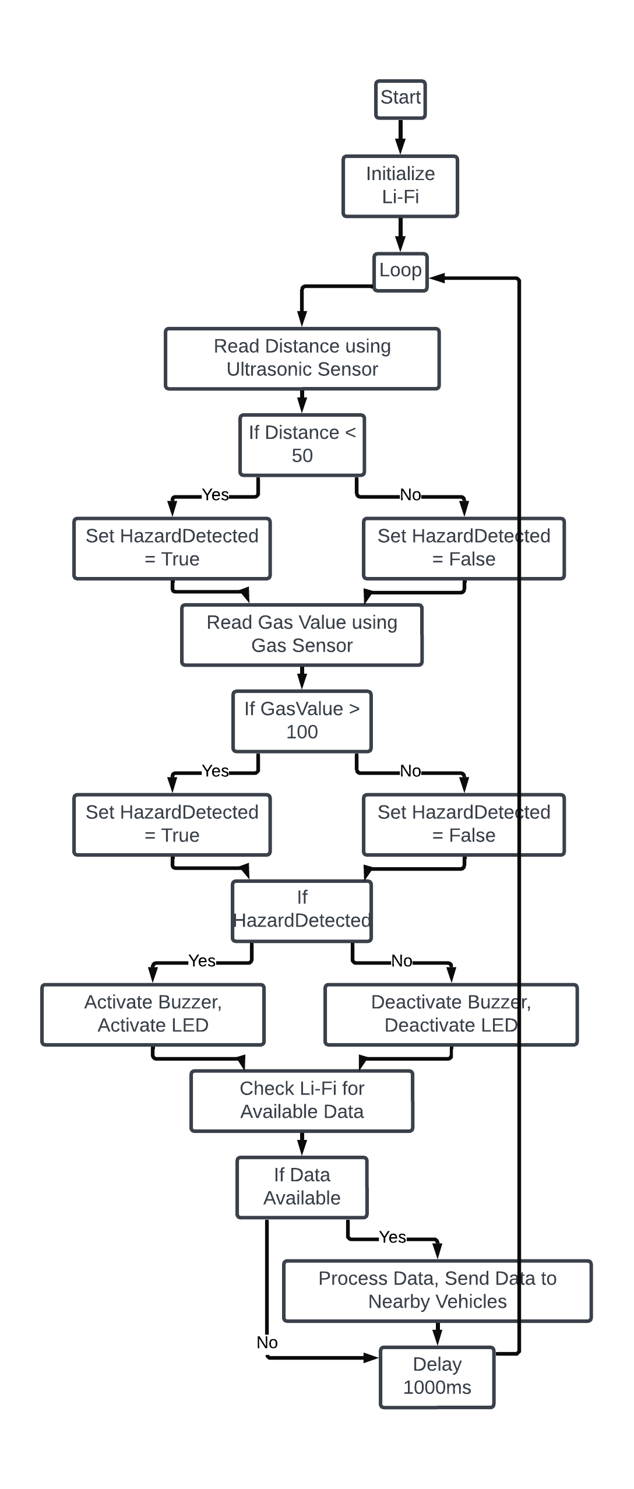
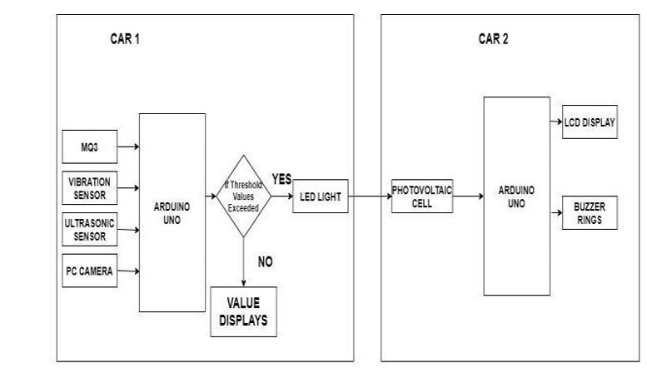
Flow Chart

Slide 8
Use Cases & Testing
Why: Testing use cases is crucial to ensure the functionality, reliability, and effectiveness of the Li-Fi V2V communication system. By conducting comprehensive testing, potential issues can be identified and addressed, ultimately enhancing road safety and preventing accidents.
What: Use cases refer to specific scenarios or situations in which the Li-Fi V2V communication system would be utilized. These could include scenarios such as highway driving, urban traffic congestion, or emergency braking situations.
Where: Testing of use cases can take place in various environments, including controlled laboratory settings, simulated driving scenarios, and real-world road conditions.
When: Use case testing should be conducted at different stages of the project, including during the development phase, prior to deployment, and periodically for ongoing system optimization and validation
How: Trying out different situations helps us understand how good the Li-Fi V2V system is. We see how far it can talk, how fast it answers and how it does in different places
Refined Objective: Ensure the effectiveness and reliability of the Li-Fi V2V communication system through comprehensive testing of use cases, ultimately contributing to enhanced road safety and accident prevention.

Slide 9
Use Cases & Testing
Use Cases:
Collision Avoidance:
Vehicles communicate with each other to detect potential collisions and automatically adjust their speed or direction to avoid accidents.
Emergency Vehicle Alert:
When an emergency vehicle approaches, nearby vehicles receive instant alerts, enabling drivers to yield and make way for the emergency vehicle to pass through quickly.
Highway Driving: Vehicles communicating with each other to maintain safe distances, avoid collisions, and coordinate lane changes on highways.
Test Cases:
Communication Range Test:
Verifying that vehicles can communicate effectively within the specified range or not
Collision Detection Test:
Simulate potential collision scenarios and verify that the system accurately detects and alerts drivers to impending collisions.
Alert Mechanism Test:
Test the effectiveness of the alert mechanisms (e.g., buzzer, LED) in capturing drivers' attention during critical situations

Slide 10
Contribution
Team Progress and Movement:
We had begin by thorough researching Li-Fi technology and its applications in V2V Communication.
We did literature survey based on above research.
Identified the major objectives of the project to achieve.
Understood about how Li-Fi Transceiver works.
Conducted a detailed survey and discussion on hardware components and software to achieve the desired objective.
The next step to integrating all hardware and software components
and test the prototype which will be done iteratively before final review.

Slide 11
Conclusion & Future Scope
Summary and Conclusion:
In conclusion, our innovative project utilizing Li-Fi technology for Vehicle-to-Vehicle (V2V) communication holds great promise for the future of road safety. As we implement this system, we anticipate significant strides in accident prevention and the creation of a safer driving environment worldwide. The integration of Li-Fi communication with a comprehensive array of sensors and alert mechanisms will enable vehicles to exchange crucial information swiftly and securely, paving the way for a future where collisions are minimized, if not altogether eliminated. With ongoing advancements and widespread adoption, we envision a world where the roads are safer, accidents are fewer, and the journey for every driver is marked by enhanced security and peace of mind.
Future Scope:
Enhancing Communication Range: Expand the reach of the Li-Fi V2V system to cover larger distances, enabling communication between vehicles over extended areas.
Integration with Autonomous Vehicles: Explore opportunities to integrate the Li-Fi V2V system with autonomous vehicles, facilitating seamless communication and collaboration between human-driven and self-driving cars.
Real-Time Traffic Management: Develop capabilities for real-time traffic monitoring and management, allowing the system to dynamically adjust traffic flow and optimize route planning based on current conditions.

Slide 12

THANK YOU

